Slide 2

ARIMA MODEL FOR
AUSTRALIA ARRIVALS FROM THE UK
GROUP 4
Tống Ngọc Huyền – 20213065
Nguyễn Ngọc Vân Khanh – 20213066
Nguyễn Đỗ Quyên – 20213093
Bùi Ánh Vân – 20213106

Slide 3
TABLE OF CONTENT
Time plot for Australia Arrivals from the UK
Stabilising data using differencing
ACF graph of differenced data
PACF graph of differenced data
Suggested model by ACF and PACF graphs
ARIMA model & the best model

Slide 4
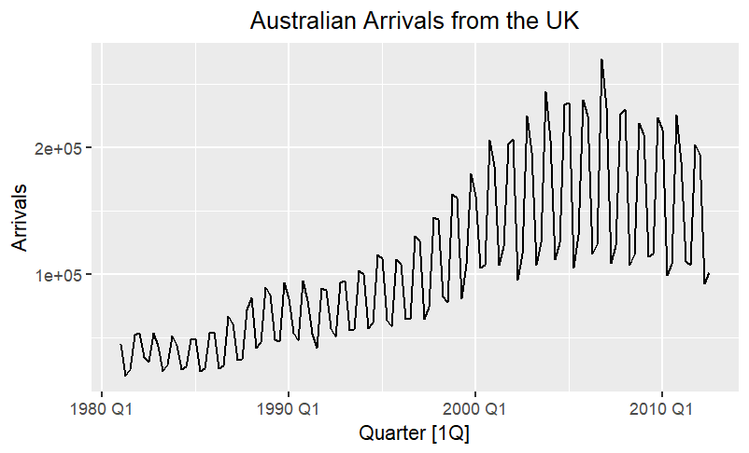
1. Time plot for Australia Arrivals from the UK
Non-stationaries in both mean and variance
The number of arrivals has unstable changes between two consecutive years and significant upward trend over the observed period

Slide 5
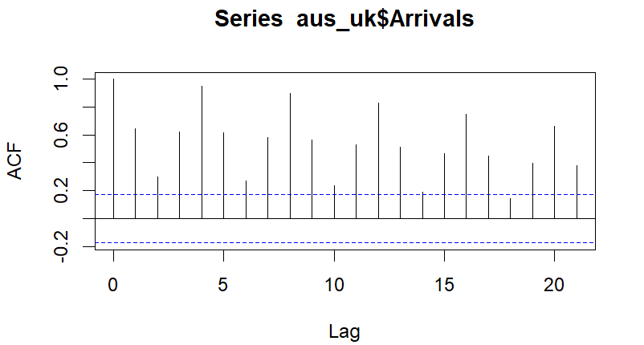
2. Stabilising data using differencing
ACF BEFORE DIFFERENCING DATA
Most values exceed the bounds of confidence intervals
Fluctuations are not white noise, there are strong patterns and underlying trends in the time series. The data can be quarterly seasonal.

Slide 6
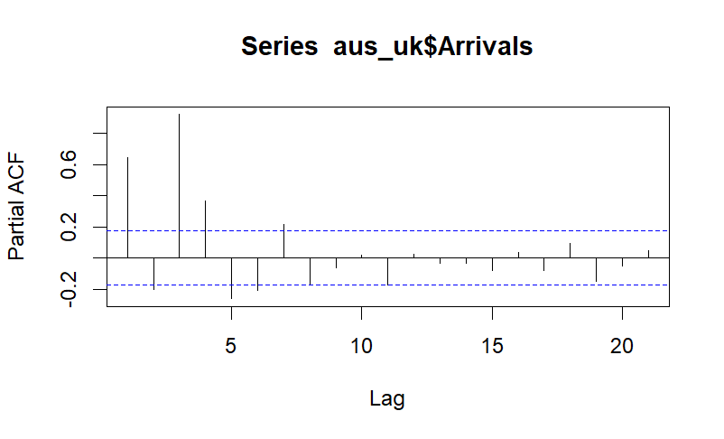
2. Stabilising data using differencing
PACF BEFORE DIFFERENCING DATA
The larger correlation occurs at lag 1, 3, and 4, which exceed confidence intervals.
The number of Australian arrivals from the UK is influenced by its immediate past value.

Slide 7
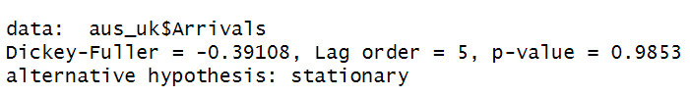
2. Stabilising data using differencing
TEST FOR STATIONARY USE THE ADF (AUGMENTED DICKEY-FULLER) TEST
P-value = 0.9853 > 0.05
We use the ADF test to determine the stationarity of a time series, so we cannot reject the null hypothesis and we can conclude that the data is non-stationary.

Slide 8
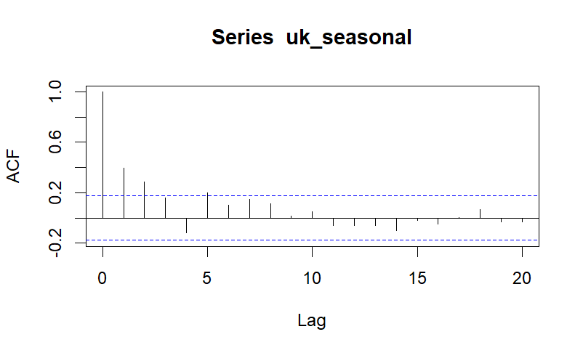
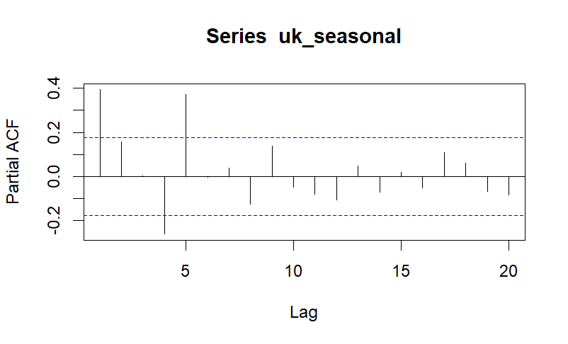
2. Stabilising data using differencing
USE 1ST DIFFERENCED DATA TO OBTAIN STATIONARITY
To stabilize the time series, we compute the differences between consecutive observations to remove the trend within it. Additionally, we use a logarithm of data to stabilize its variance and apply a lag of 4 to the differenced data.

Slide 9
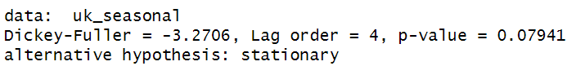
2. Stabilising data using differencing
TEST FOR STATIONARY USE THE ADF (AUGMENTED DICKEY-FULLER) TEST
P-value = 0.079 > 0.05
We use the ADF test to determine the stationarity of a time series, so we cannot reject the null hypothesis and we can conclude that the data is non-stationary.

Slide 10
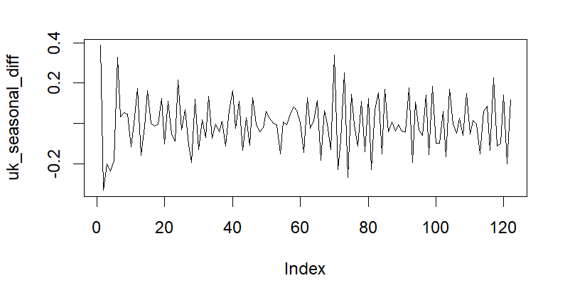
2. Stabilising data using differencing
USE SECOND-ORDER DIFFERENCED DATA TO OBTAIN STATIONARITY
To continue stabilizing the data, we execute the second-order differencing on the logarithmically transformed data of the quarterly number of Australian arrivals from the UK and apply a lag of 4 to the differenced data. Observations have fluctuated around means and stable variables.

Slide 11
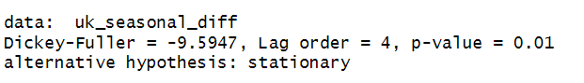
2. Stabilising data using differencing
TEST FOR STATIONARY USE THE ADF (AUGMENTED DICKEY-FULLER) TEST
P-value = 0.01 < 0.05
We use the ADF test to determine the stationarity of a time series, so we can reject the null hypothesis and we can conclude that the data has become stationary.

Slide 12
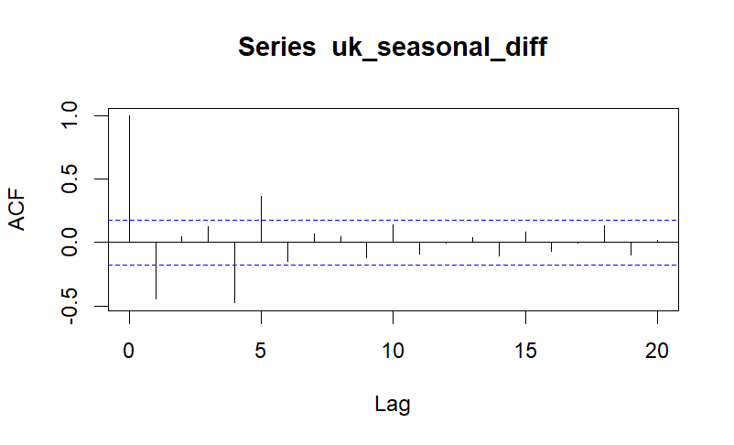
3. ACF graph of differenced data
The ACF values decrease as the lag increases
A decrease in the correlation between the differenced data at larger time lags.

Slide 13
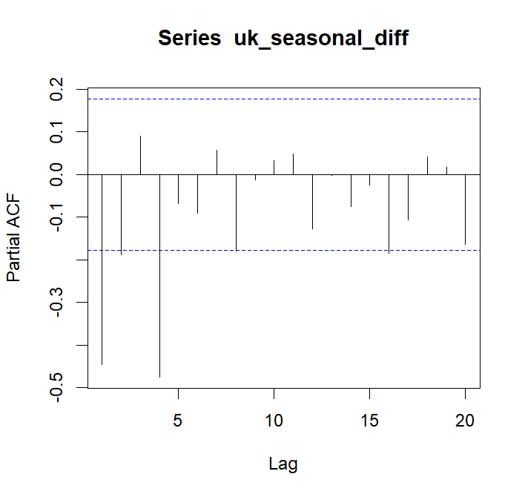
4. PACF graph of differenced data
The lag increases, the partial autocorrelation values gradually decrease and tend to approach 0
There are no significant correlations between observations at different lags in the differenced data
Differenced data of the quarterly number of Australian arrivals from UK is stationarity.

Slide 14
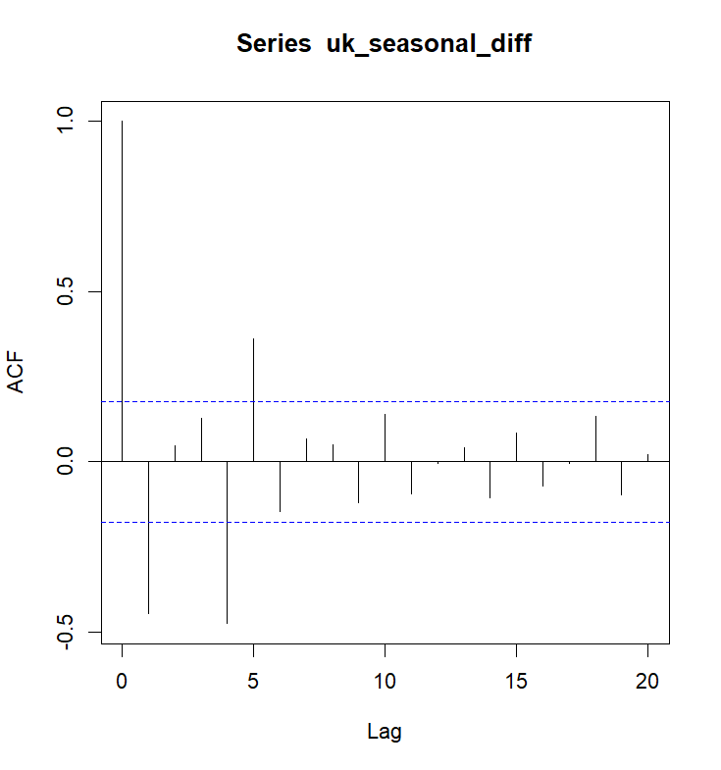
5. ARIMA model
ARIMA (4,1,2) and ARIMA (4,0,2) with p, d, q respectively.
p: the number of lags that have significant spike at ACF chart.
q: the number of lags that have significant spike at PACF chart.
d: the different times required for converting to stationary data.

Slide 15
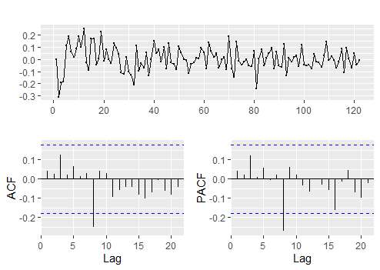
5. ARIMA model
ARIMA (4,1,2)
The residual plot of model ARIMA (4,1,2) are randomly scattered around zero, with no apparent patterns or trends. Therefore, this is a quite well-fitting ARIMA model.
P-value for testing autocorrelation of ARIMA (4,1,2) = 0.6572 > 0.05. It shows that there is not enough evidence to reject null hypothesis. Therefore, the residual of model is no autocorrelation.
AIC = -199.537

Slide 16
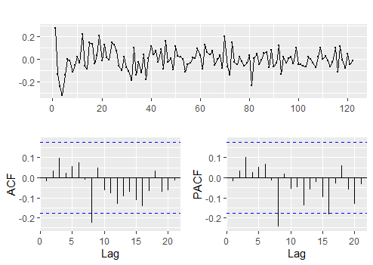
5. ARIMA model
ARIMA (4,0,2)
The residual plot of model ARIMA (4,1,2) are randomly scattered around zero, with no apparent patterns or trends. Therefore, this is a quite well-fitting ARIMA model.
P-value for testing autocorrelation of ARIMA (4,1,2) = 0.8385 > 0.05. It shows that there is not enough evidence to reject null hypothesis. Therefore, the residual of model is no autocorrelation.
AIC = -208.28

Slide 17
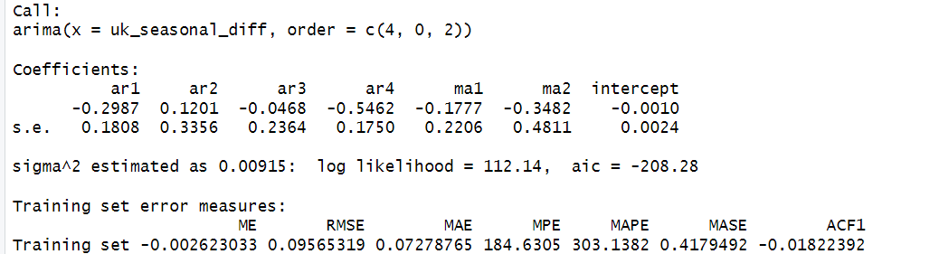
5. ARIMA model
ARIMA (4,0,2)

Slide 18
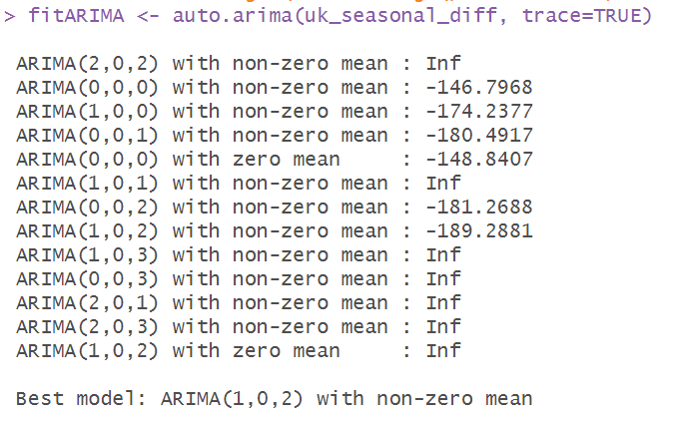
6. AUTO ARIMA model
Helping in automatically selecting an appropriate ARIMA model by considering the AIC values and the model order
AIC = -189.81
ARIMA (1,0,2)

Slide 19
6. AUTO ARIMA model
(fit) ARIMA (4,1,2)
AIC = -199.537
(fit1) ARIMA (4,0,2)
AIC = -208.2804
(auto_arima) ARIMA (1,0,2)
AIC = -189.81
Lower AIC values indicate a better fit, with a lower level of information loss and more efficient model representation
(fit1) ARIMA (4,0,2)

Slide 20
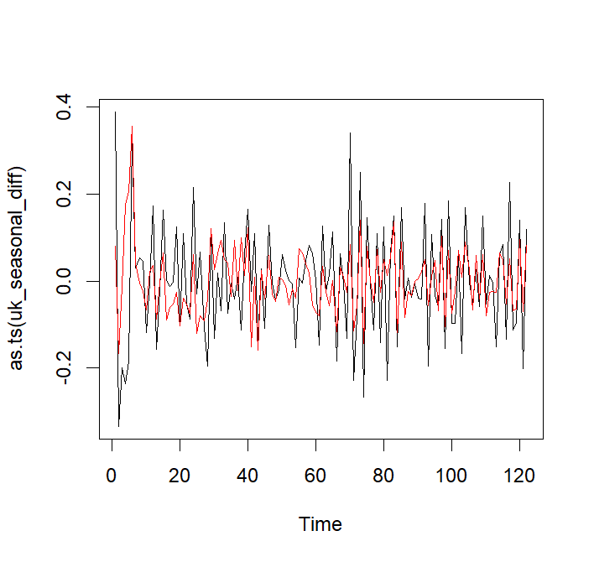
5. ARIMA model
Based on the plot and the Box-Ljung test, the fitARIMA model appears to provide a reasonable fit to the uk_seasonal_diff data, and there is no significant autocorrelation remaining in the model’s residuals.

Slide 21
THANK YOU !

